Slide 1

Stroke Prediction
Sofia Mirshed
Fullstack Academy
Capstone Project

Slide 2
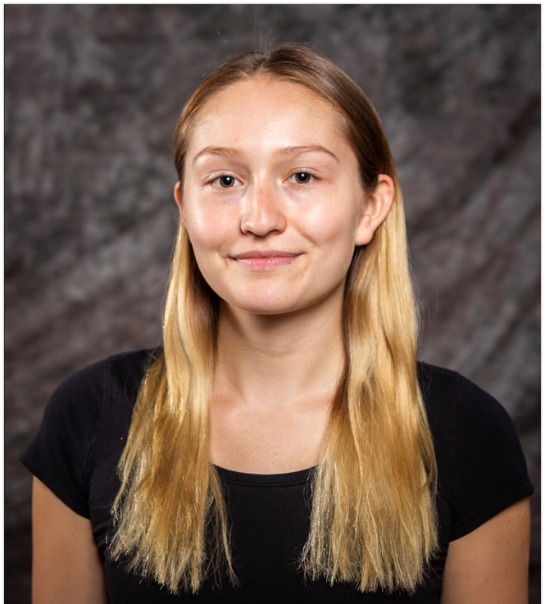
Introduction
My name is Sofia Mirshed, my background is in healthcare.
My long-term goal is to improve people’s lives and drive innovation in medicine.
Contact Info:
sofia.mirshed@gmail.com
Notes:
Along with my interest in healthcare, I chose this topic because my grandmother recently suffered a stroke and I wanted to learn more about it them and why they occur. She is recovering remarkably.

Slide 3
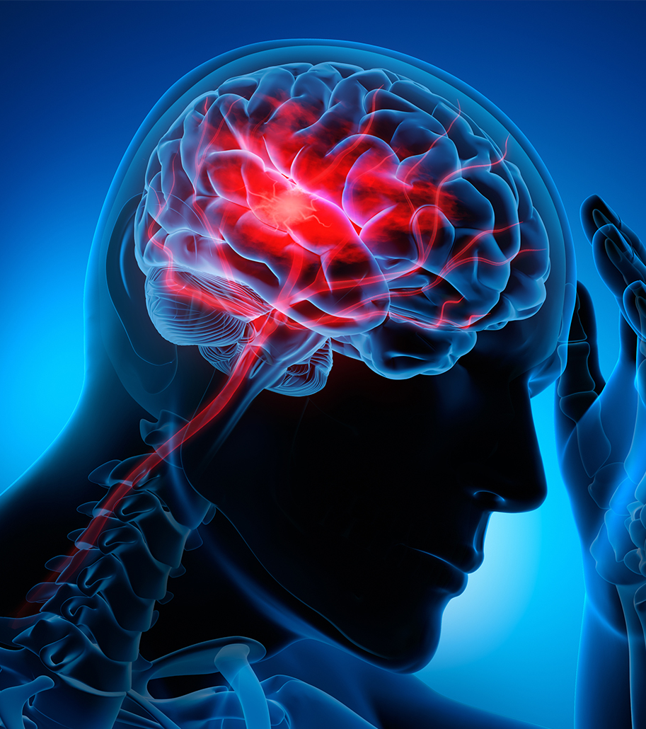
Background Info
Every 40 seconds someone in the United States has a stroke.
Every 3.5 minutes someone dies of stroke.
Notes:
For those who don’t know, strokes are when the blood flow to the brain is interrupted by either a clot, a bleed, or in some cases both.
This is not only a prevalent issue but also a deadly one.

Slide 4
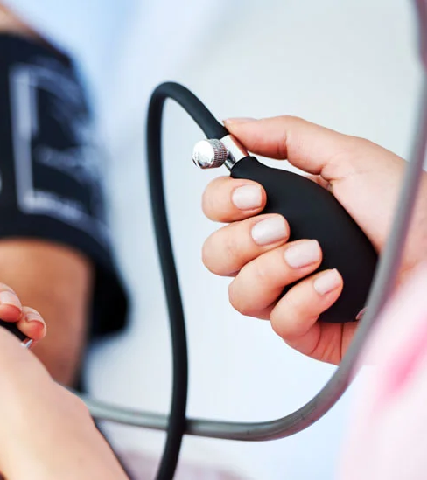
Who is affected?
High blood pressure
High cholesterol
Smoking
Obesity
Diabetes
1 in 3 US adults have at least one.
Notes:
These are the leading causes of stroke and they are very common conditions.

Slide 5
Goals
ASCVD is the most used risk estimator currently for cardiovascular disease, developed in 2013.
Build a predictive model for strokes.
Predicting strokes leads to stroke prevention.
Notes:
There is a risk estimator for predicting cardiovascular disease that is widely used in medical practice, it was created in 2013 and needs updating.
I liked the idea of it so I wanted to build a predictive model for strokes specifically. I figure if we can predict strokes, we can potentially prevent them.

Slide 6
Data Info
Attributes | Information
id | Unique identifier
gender | “Male”, “Female”, or “Other”
age | Age of patient
hypertension | 0 for No hypertension, 1 for hypertension
heart_disease | 0 for No heart disease, 1 for heart disease
ever_married | “Yes” or “No”
work_type | “children”, “Govt_job”, “Never_worked”, “Private” or “Self-employed”
Residence_type | “Rural” or “Urban”
avg_glucose_level | Average glucose level in blood
bmi | Body mass index
smoking_status | “Unknown”, “never smoked”, “formerly smoked”, “smokes”
stroke | 1 if patient had a stroke, 0 if not
From Kaggle:
5110 observations
12 attributes
11 clinical features
Notes:
I found a dataset on Kaggle that had a high usability rating. It contained 11 different features for health and demographics for over 5,000 patients with stroke as 1 and no strokes as 0. Some data features were categorical and some were numerical. I used Excel, Python and Tableau for this project.

Slide 7
Data Wrangling & Cleaning
Found 201 null values for bmi, filled with mean.
01
Converted categorical data to numerical.
02
Dropped ID column.
03
Notes:
I found 201 null values for BMI which I decided to fill with the mean because there weren’t very many and I wanted to use as much data as possible for my models because it is a small dataset.
I then converted categorical data to numerical and sorted them. For example, I assigned a greater value to currently smokes and a smaller value to never smoked as there is implied importance.

Slide 8
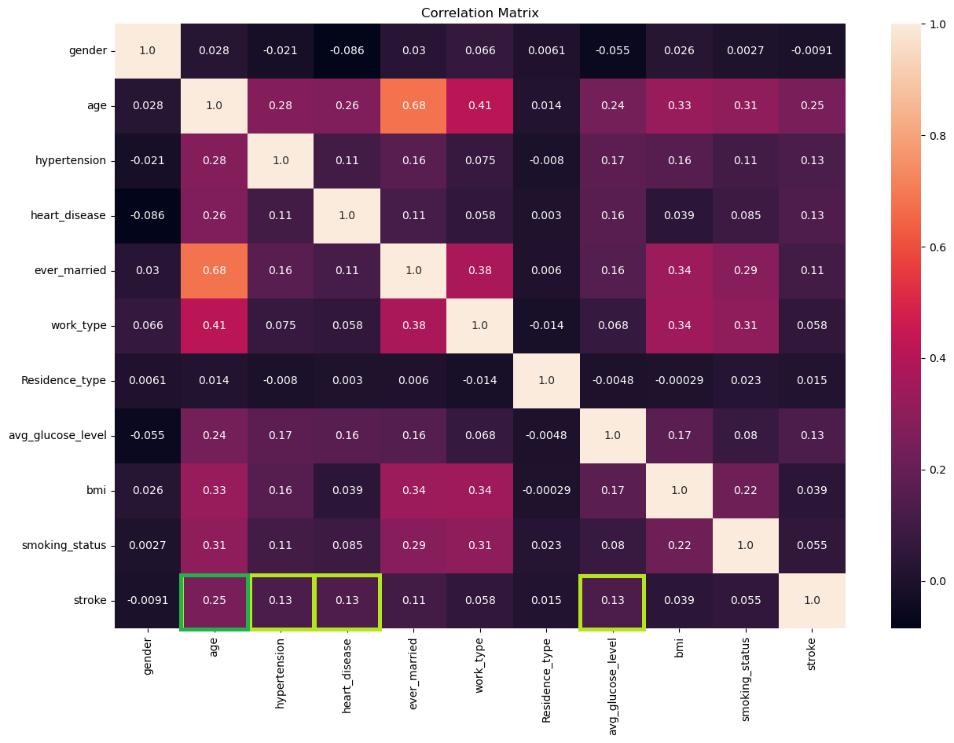
What attributes are associated with stroke?
Most correlated with stroke:
Age
Hypertension
Heart disease
Average glucose level
Notes:
I was able to create a correlation matrix which is very pretty but shows the strength of relationships between each of the features.
I was focused on stroke as my outcome and it shows age is most correlated with stroke.
Then Hypertension, Heart Disease, and average glucose level.

Slide 9
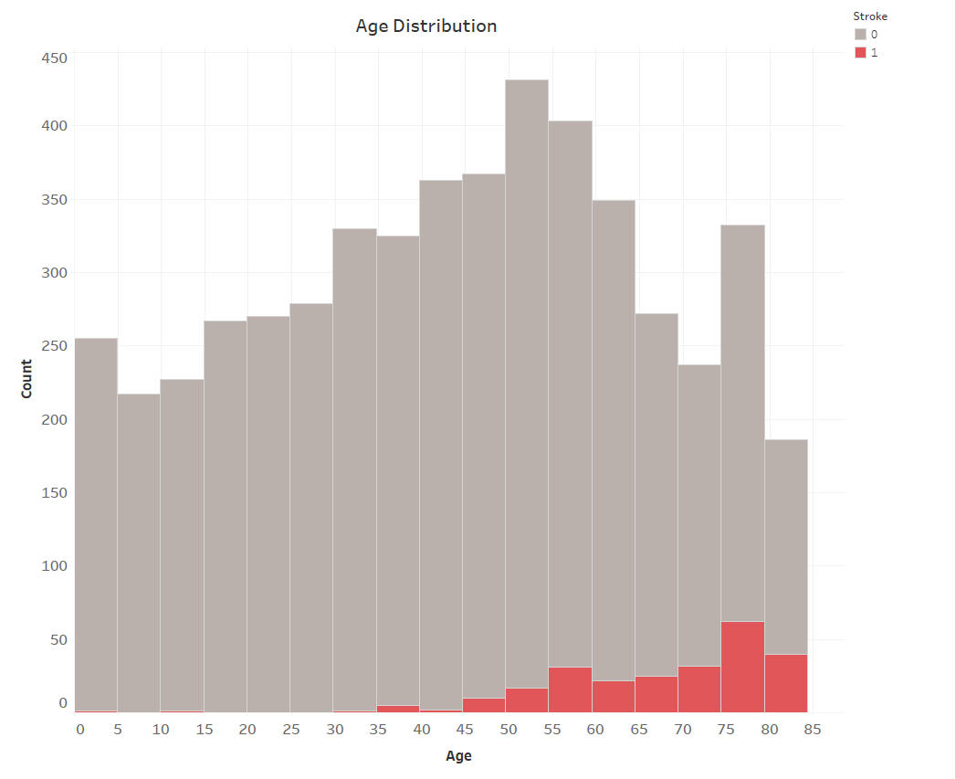
Age
Large age range: 0-82 years.
Older adults tend to have strokes.
Notes:
When I looked at the distribution of age I found that the age range is very large from 0 to 82 years old.
The overall distribution of ages is normal but the distribution for those who had a stroke is skewed as you can see in the red.
This confirms that older people tend to have strokes.

Slide 10
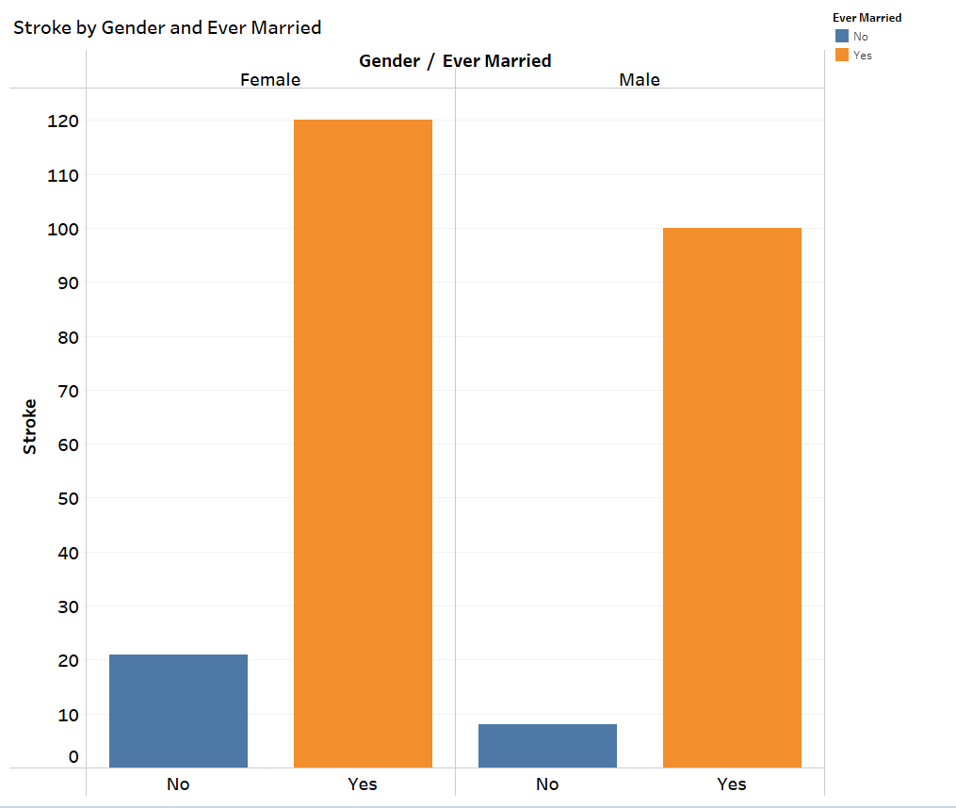
If you’ve been married, you’re at risk.
Notes:
If you have been married, you’re at risk! It is more known that females have a higher risk of stroke than males which is supported in this set but I found it interesting that there is a much larger difference in instances of stroke for people who have been married compared to people who have not.

Slide 11
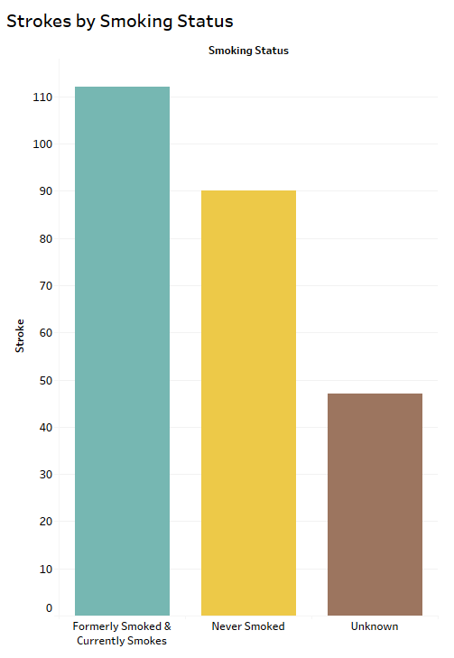
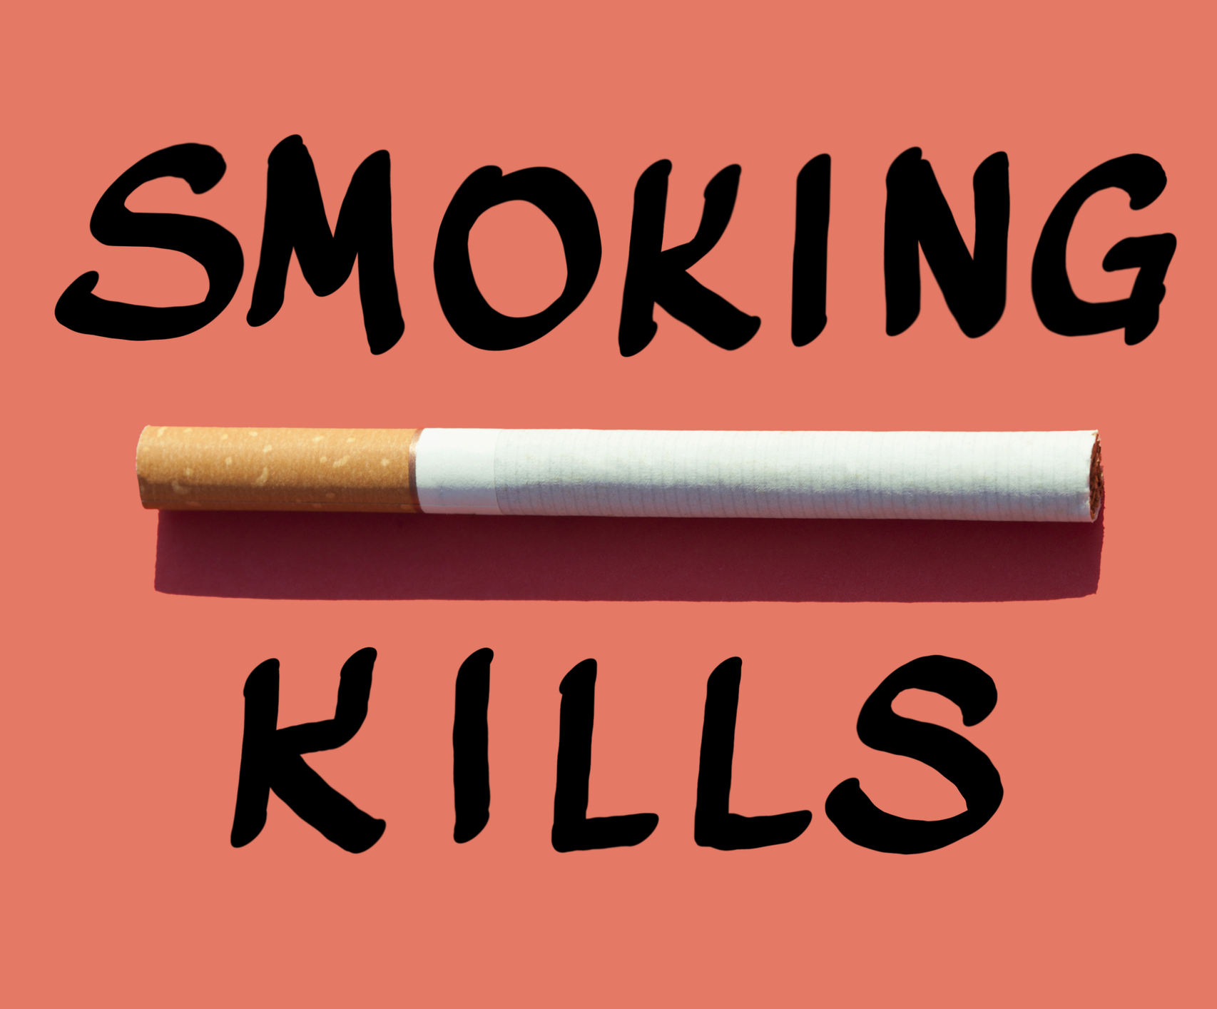
Notes:
We all know that smoking is dangerous but we most commonly attribute it to lung disease. Here I was able to group formerly smoked and currently smokes to show that any history of smoking leads to more strokes than in those who have never smoked.

Slide 12
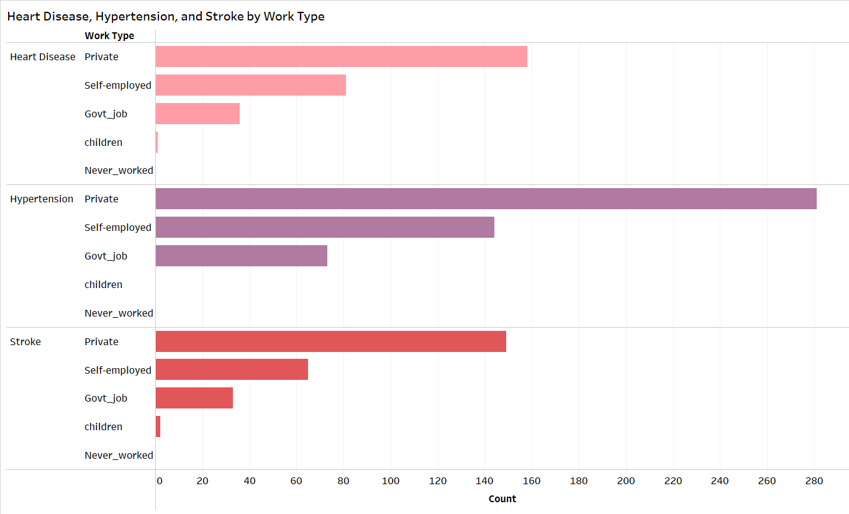
Notes:
I also found it interesting to look at heart disease, hypertension and stroke by work type where I noticed that across the board there are far more people who suffer from one of these conditions who work in the private sector compared to other work types.

Slide 13
Machine Learning
Algorithm | Accuracy
Logistic Regression | 94.12%
Random Forest | 93.83%
Decision Tree | 90.61%
Notes:
Finally, machine learning! I used three different algorithms for my models, logistic regression, random forest and decision tree.

Slide 14
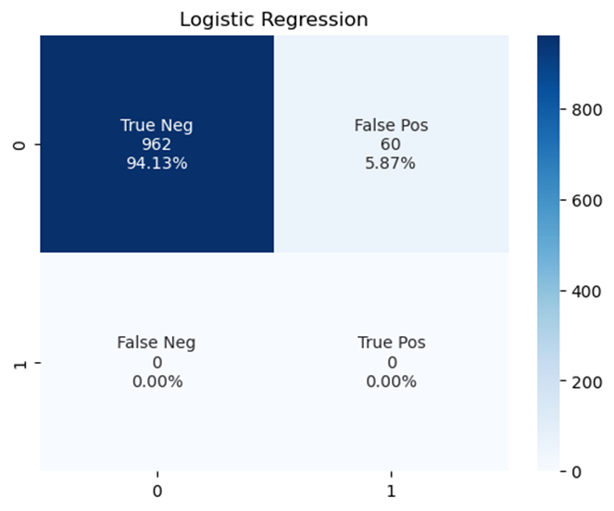
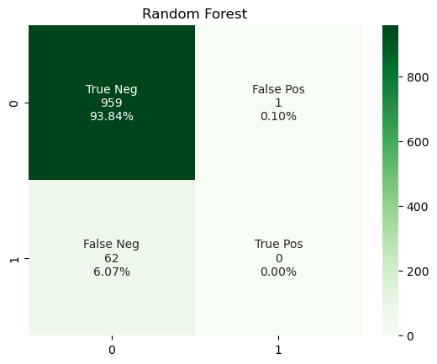
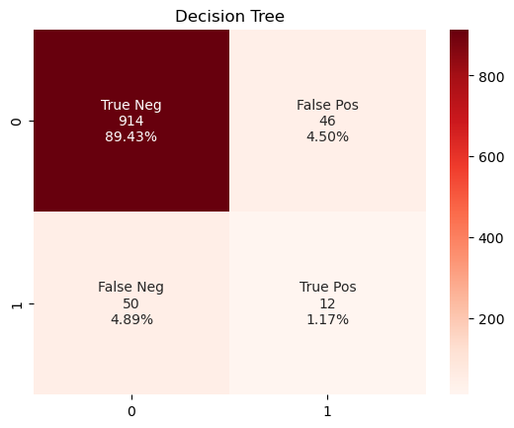

Confusion Matrices
Accuracy = 94.12%
Accuracy = 93.83%
Accuracy = 90.61%
Notes:
Looking at the confusion matrices helped me to determine which model worked best. My goal was to build a model that would predict strokes which is shown in the true positive section of the matrix.
Decision Tree was the only model to have any true positive values and although its accuracy is lower than the other models, it is the only one that is actually predicting strokes so it is more precise in obtaining the results I was aiming for.

Slide 15
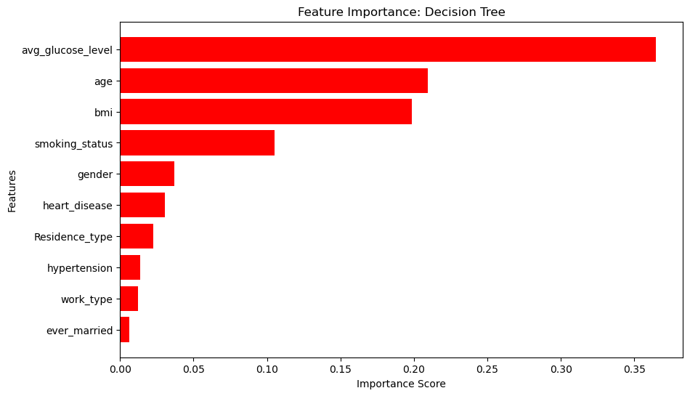
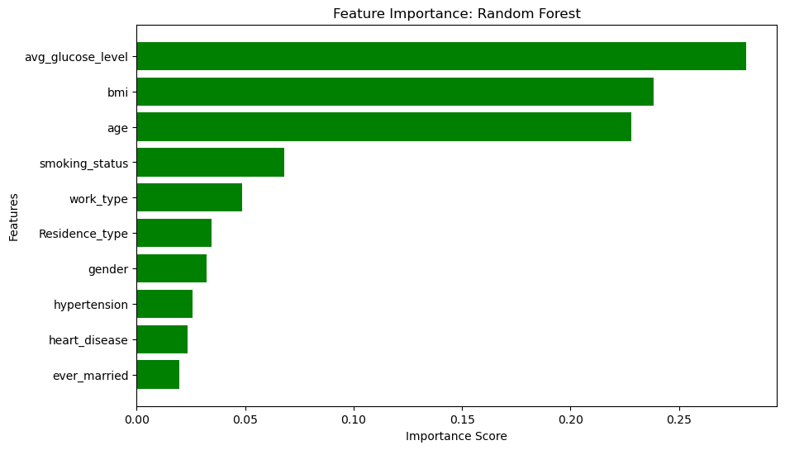
Feature Importance: Classifiers
Notes:
I then looked at feature importance of the classifier models. I learned that regression models work better for continuous outcomes and since my outcome of stroke was binary or discrete, classifiers work best.
Both models read average glucose levels as of highest importance for prediction. The decision tree though, put age above bmi which aligns with my previous findings where age is more correlated with stroke.

Slide 16
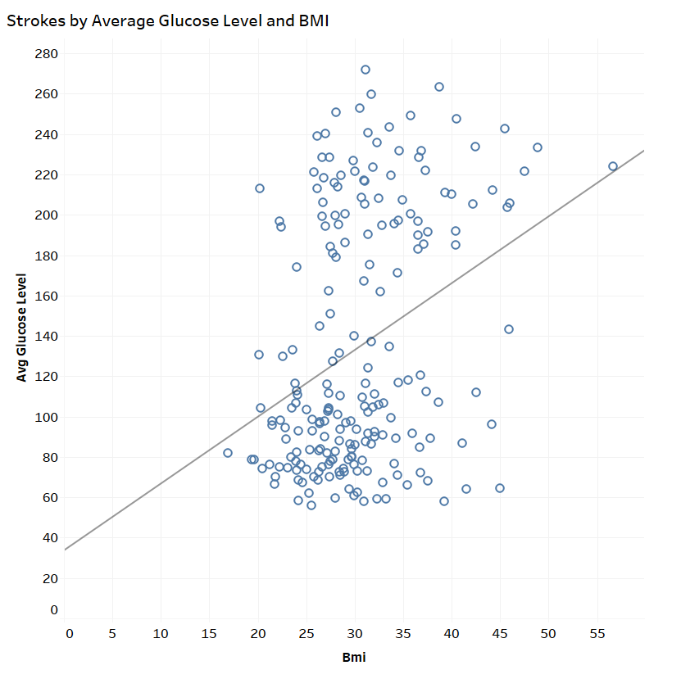
Strong positive correlation.
Average glucose and BMI closely ranked in importance.
Notes:
Both classifier models ranked average glucose level and BMI as of high importance and we can see here that these features have a strong positive correlation which may explain why they are of similar importance in the models.

Slide 17
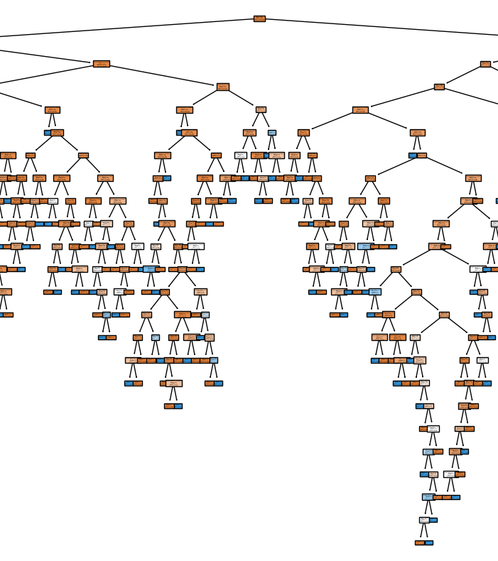
Conclusion
Decision tree is the best model.
Lower accuracy but predicted true positives.
Average glucose level and Age are important.
Notes:
To recap, I chose the decision tree as the best model for this dataset. Although it had the lower accuracy, it was the only one with true positives and actually predicts strokes.
The feature importance also aligned with our earlier correlational findings where average glucose levels and age are important predictors.

Slide 18

Limitations and Future
Dataset is too small.
The age range is too large.
Decision Tree can be strengthened.
Notes:
I learned that the accuracies were so high because the dataset was too small to run a strong predictive model. The age range was sol large it was skewing the data as none of the risk factors even accounted for reasons for strokes in children and young adults ie. Leukemia. I think the decision tree would be stronger with a larger dataset and possibly if we only looked at older adults.

Slide 19
Resources
https://www.cdc.gov/stroke/facts.htm
https://www.kaggle.com/datasets/fedesoriano/stroke-prediction-dataset
https://www.stat.cmu.edu/capstoneresearch/spring2021/315files/team16.html

Slide 20

Questions?

Slide 21

Thank you!
Fullstack Academy
Instructors: Mel and Daniel

